Slide 1
Object-Oriented Programming Language
Java is a computer programming language that is concurrent, class-based and object-oriented. The advantages of object oriented
software development are shown below:
• Modular development of code, which leads to easy maintenance and modification.
• Reusability of code.
• Improved reliability and flexibility of code.
• Increased understanding of code.
Object-oriented programming contains many significant features, such as encapsulation, inheritance, polymorphism and abstraction.

Slide 2
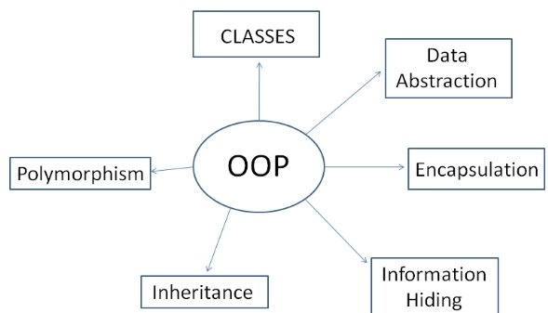

Slide 3
Structured Programming | Object Oriented Programming
Structured Programming is designed which focuses on process/ logical structure and then data required for that process. | Object Oriented Programming is designed which focuses on data.
Structured programming follows top-down approach. | Object oriented programming follows bottom-up approach.
Structured Programming is also known as Modular Programming . . | Object Oriented Programming supports inheritance, encapsulation, abstraction, polymorphism, etc.
In Structured Programming, Programs are divided into small self contained functions. | In Object Oriented Programming, Programs are divided into small entities called objects.
Structured Programming is less secure as there is no way of data hiding. | Object Oriented Programming is more secure as having data hiding feature.
Structured Programming provides less reusability, more function dependency. | Object Oriented Programming provides more reusability, less function dependency.
Less abstraction and less flexibility. | More abstraction and more flexibility.

Slide 4
Java Terminologies You Need to Know Before You Start
JVM - JVM (Java Virtual Machine) is an abstract machine that enables your computer to run a Java program.
JRE - JRE (Java Runtime Environment) contains JVM, supporting libraries, and other components to run a Java program. However, it doesn't contain any compiler and debugger.
JDK - JDK (Java Development Kit) contains JRE and tools such as compilers and debuggers for developing Java applications.

Slide 5
Primitive Data Types
byte: The byte data type is an 8-bit signed two's complement integer. It has a minimum value of -128 and a maximum value of 127 .
short: The short data type is a 16-bit signed two's complement integer. It has a minimum value of -32,768 and a maximum value of 32,767.
int: By default, the int data type is a 32-bit signed two's complement integer, which has a minimum value of -2³¹ and a maximum value of 2³¹-1.
long: The long data type is a 64-bit two's complement integer. The signed long has a minimum value of -2⁶³ and a maximum value of 2⁶³-1.
float: The float data type is a single-precision 32-bit floating point .
double: The double data type is a double-precision 64-bit floating point.
boolean: The boolean data type has only two possible values: true and false.
char: The char data type is a single 16-bit Unicode character.

